Slide 1
Coursera Capstone project
Prediction Model of Heart Failure Risk of Patients
By Alec Xu
Aug 2020

Slide 2
Introduction
Cardiovascular diseases (CVDs) are the No.1 cause of death globally, taking an estimated 17.9 million lives each year, which accounts for 31% of all deaths worldwide. Heart failure is a common event caused by CVDs and it means the heart is unable to pump sufficiently to maintain blood flow to meet the body's needs.
Most cardiovascular diseases can be prevented by addressing behavioral risk factors such as tobacco use, unhealthy diet and obesity, physical inactivity and harmful use of alcohol using population-wide strategies.
People with cardiovascular disease or who are at high cardiovascular risk (due to the presence of one or more risk factors such as hypertension, diabetes, hyperlipidemia or already established disease) need early detection and management wherein a machine learning model can be of great help. That is the starting point that I will use different modelling methods to estimate the risk that a person may get heart failure as an effective reference to support the media examination of hospital.

Slide 3
Target Audience
The target audience of this modelling studying is not just the medical researchers or doctors, but also the patients who have strong concerns on their health threatened by cardiovascular diseases to raise their awareness of some negative signals of heart failure.

Slide 4
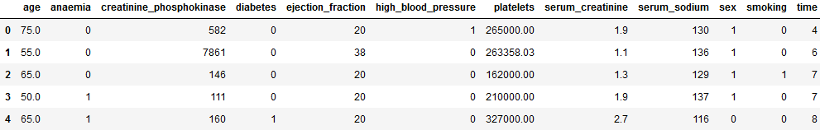
Data
This dataset contains 12 features that can be used to predict mortality by heart failure is obtained from Kaggle with the link below.
https://www.kaggle.com/andrewmvd/heart-failure-clinical-data?select=heart_failure_clinical_records_dataset.csv
Sample data:

Slide 5
Methodology
To build a proper prediction model for heart failure event, I will use three modelling methods in order to compare their model accuracy：
Logistic Regression
SVM
Decision Tree
Then I will compare their accuracy rates and the most accurate model will be recommended to audience for reference and further study.

Slide 6
Result
 | Logistic Regression | SVM | Decision Tree
Accuracy score | 0.82 | 0.83 | 0.81
The scores of three models are very close but the SVM model is a bit higher than the other two. Therefore in this project SVM is the best model to predict heart failure event for patients.

Slide 7
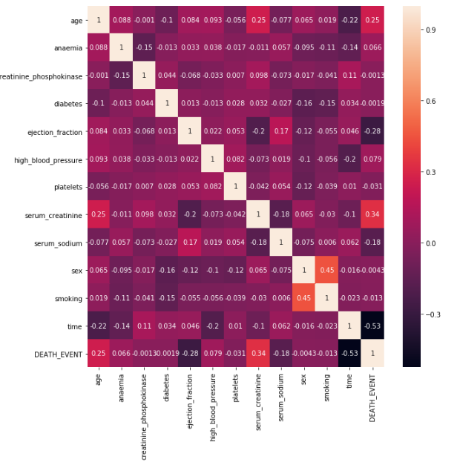
Result
I also calculated the correlation among all factors and found four of them have significant positive effect on the death event.
Age
Anaemia
High blood pressure
Serum creatinine

Slide 8
Discussion
This project still has some limitation that can be further studied:
It is unknown that whether other models like random forest can have a better prediction performance than three models I used.
The 12 attributes included in this project may not be fully cover all the important factors that will impact on the heart failure.
The model accuracy may be higher if some of the insignificant factors can be removed from the data sets.

Slide 9
Conclusion
In this capstone project, I only tested three machine learning models to predict whether a patient would suffer the risk of heart failure. And the SVM model stands out to be the most reliable model that worth further study by medical researcher and if doctors collected those 12 factors of patients, they may enter those data into the SVM model to forecast their heart failure risks and prepare more careful nursing to those patients predicted to be burdened with the cardiovascular disease.

